Slide 1
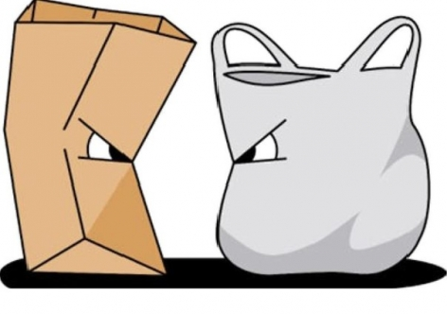
Paper bags vs. plastic bags

Slide 2

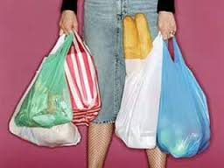

Slide 3
1.renewable – another name for alternative energy
2.resource – oil, gas, wood and so on
3.recycling – to repeat using
4.decompose – to be broken down physically and chemically by bacterial action
5.wood chips – small pieces of wood
6.paper pulp – soft mass
7.bleach – to make or become white or colourless

Slide 4
8.chemicals – substances used in chemistry
9.harm – hurt , injury , damage
10.pollution – dirtying
11. manufacturing – to process or make a product from a raw material
12.landfill site (landfills) – waste material buried under layers of earth

Slide 5
1.What I already know
2.What I want to know
3.What I learned
4.How I can learn more

Slide 6

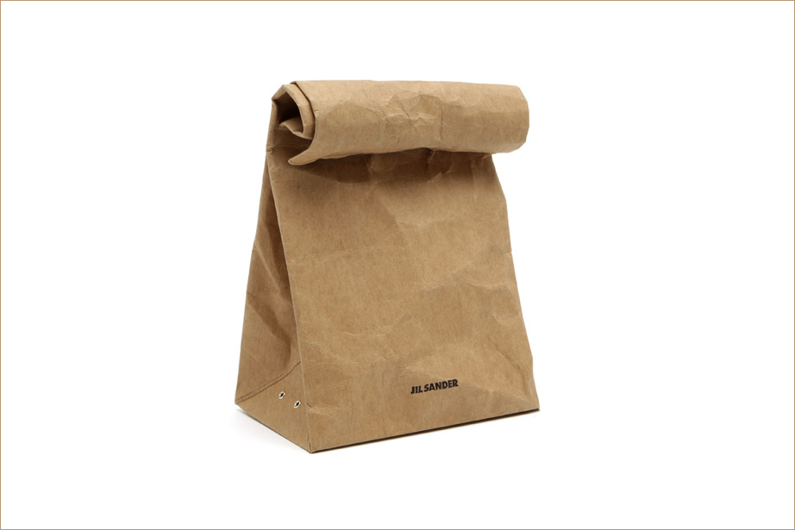
Advantages and Disadvantages .

Slide 7


